Slide 1
Amazon Simple Queue Service
Lecturer: Ngo Huy Bien
Software Engineering Department
Faculty of Information Technology
University of Science
Ho Chi Minh City, Vietnam
nhbien@fit.hcmus.edu.vn

Slide 2

Objectives

Slide 3

Contents

Slide 4

References

Slide 5
Amazon Simple Queue Service
https://aws.amazon.com/sqs/
Amazon Simple Queue Service (Amazon SQS) lets you send, store, and receive messages between software components at any volume, without losing messages or requiring other services to be available.
SQS is pull-based delivery system.
Visibility timeout: The length of time that a message received from a queue (by one consumer) won't be visible to the other message consumers.

Slide 6


Storage First Pattern
https://aws.amazon.com/blogs/compute/building-storage-first-applications-with-http-apis-service-integrations/
Common pattern for serverless API backend
Storage first pattern for serverless API backend

Slide 7
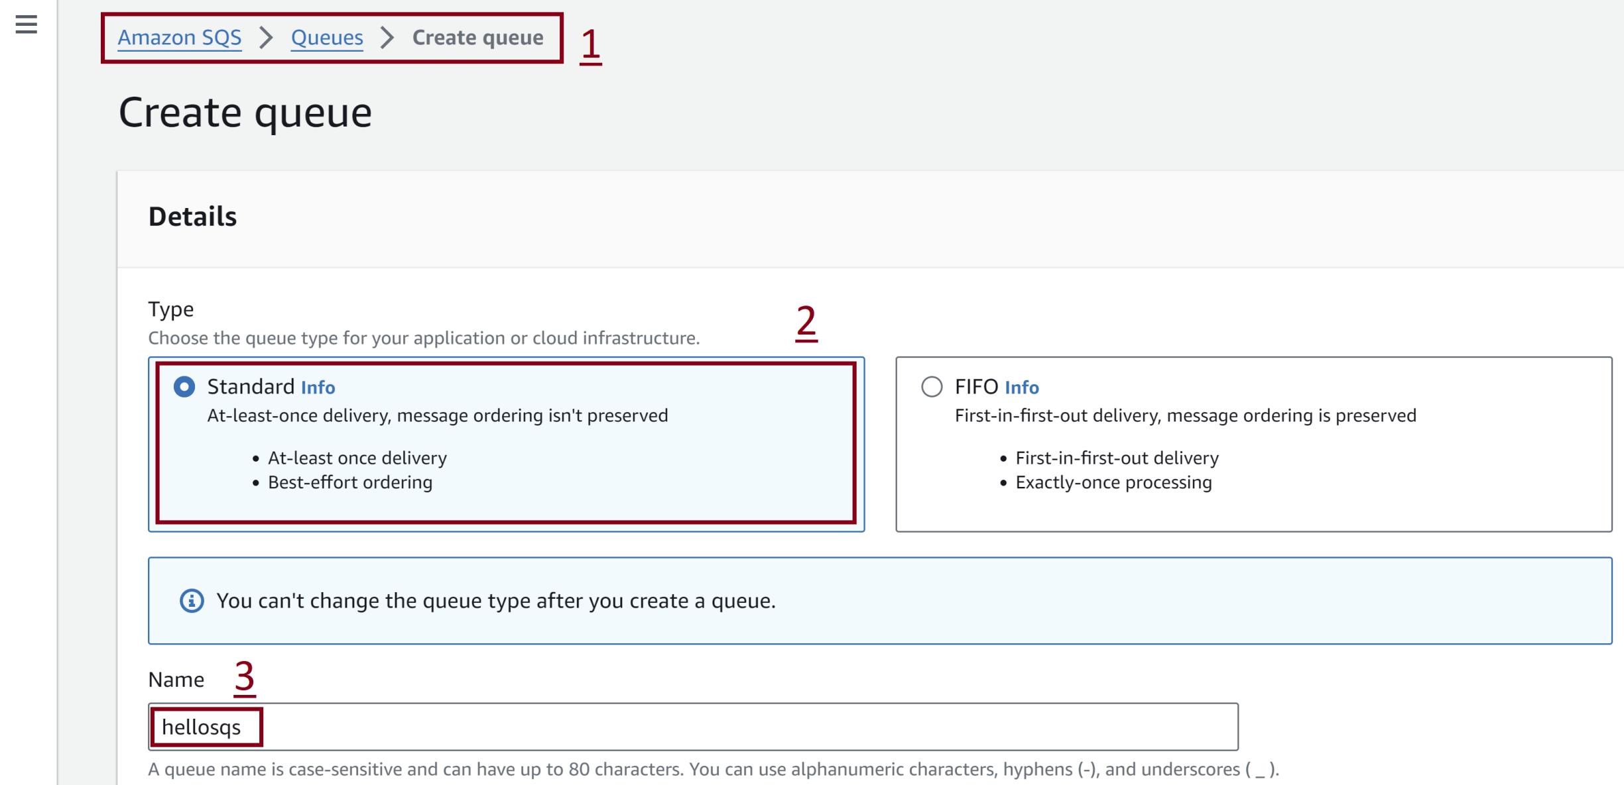
1. Create Amazon SQS Queue

Slide 8
2. Install AWS SDK for Python (Boto3)
pip install boto3

Slide 9
3. Configuring Boto3
aws configure

Slide 10
4. Send Message
import boto3
import json
def send_message():
sqs_client = boto3.client("sqs", region_name="us-east-1")
message = {"key": "value"}
response = sqs_client.send_message(
QueueUrl="https://sqs.us-east-1.amazonaws.com/135319629286/hellosqs",
MessageBody=json.dumps(message)
)
print(response)
send_message()

Slide 11


Slide 12
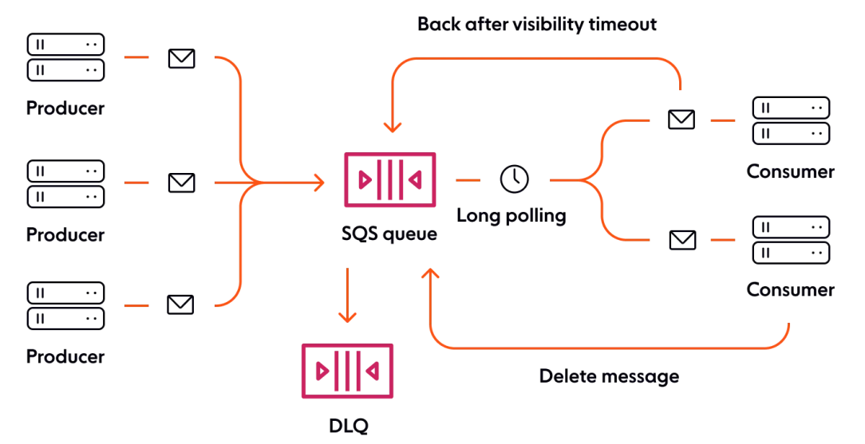
Distributed Queueing Service
Producers (components that send messages to the queue).
Queue (which stores messages).
Consumers (other components that receive messages from the queue).
Dead-letter queues (DLQ) exist alongside regular message queues. They act as temporary storage for erroneous and failed messages.

Slide 13
Setting the Visibility Timeout
https://docs.aws.amazon.com/AWSSimpleQueueService/latest/SQSDeveloperGuide/working-with-messages.html#processing-messages-timely-manner
Setting the visibility timeout depends on how long it takes your application to process and delete a message. For example, if your application requires 10 seconds to process a message and you set the visibility timeout to 15 minutes, you must wait for a relatively long time to attempt to process the message again if the previous processing attempt fails.
Alternatively, if your application requires 10 seconds to process a message but you set the visibility timeout to only 2 seconds, a duplicate message is received by another consumer while the original consumer is still working on the message.

Slide 14
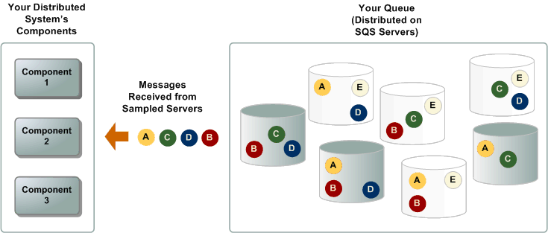
Short Polling
When the wait time for the ReceiveMessage API action is 0, short polling is in effect.
When you consume messages from a queue by using short polling, Amazon SQS samples a subset of its servers (based on a weighted random distribution) and returns messages from only those servers.
Thus, a particular ReceiveMessage request might not return all of your messages. However, if you have fewer than 1,000 messages in your queue, a subsequent request will return your messages.
If you keep consuming from your queues, Amazon SQS samples all of its servers, and you receive all of your messages.

Slide 15
Long Polling
When the wait time for the ReceiveMessage API action is greater than 0, long polling is in effect.
The maximum long polling wait time is 20 seconds.
Long polling helps reduce the cost of using Amazon SQS by reducing the number of empty responses (when there are no messages available for a ReceiveMessage request) and false empty responses (when messages are available, but aren't included in a response).

Slide 16
Short Polling vs. Long Polling
https://docs.aws.amazon.com/AWSSimpleQueueService/latest/SQSDeveloperGuide/sqs-short-and-long-polling.html
With short polling, the ReceiveMessage request queries only a subset of the servers (based on a weighted random distribution) to find messages that are available to include in the response. Amazon SQS sends the response right away, even if the query found no messages.
With long polling, the ReceiveMessage request queries all of the servers for messages. Amazon SQS sends a response after it collects at least one available message, up to the maximum number of messages specified in the request. Amazon SQS sends an empty response only if the polling wait time expires.

Slide 17

Thank You & See You Again

